Slide 1
Advanced Object – Oriented Design &Programming (AOODP) Seminar – 1: Unit 1 Introduction and Recap of Object-Oriented Programming
Dr. Anupam Mazumdar
Email: anupam.mazumdar@kaplan.com
anupam.mazumdar@aspectworld.com
24/10/2025

Slide 2
Outlines of the Seminar -1
Introduction to the module
Aims and Objectives of the module
Organisation of the seminars
Organisation of the assessments
Recap of OOP concepts
Seminar Questions & Answers
References

Slide 3
Aims of the Module
Advanced OOP concepts: deepen your understanding of OOP principles, design patterns, and software architecture.
Practical application: apply your knowledge through coding exercises, case studies, and a capstone project.
Real-world relevance: learn how to design software that addresses societal challenges, including sustainability and inclusivity.
Collaborative learning: engage with peers and instructors through live seminars and online forums
Career preparation: gain skills that are highly relevant to careers in cybersecurity, data science, AI, and more.

Slide 4
Objectives of the Module
Understand and implement secure coding practices in software development.
Apply advanced object-oriented principles to solve complex software problems.
Utilise design patterns to create reusable, maintainable, and flexible code.
Design software architectures suitable for large-scale systems, ensuring security and robustness.
Develop software solutions that are adaptable for AI models and efficient for data science tasks.

Slide 5
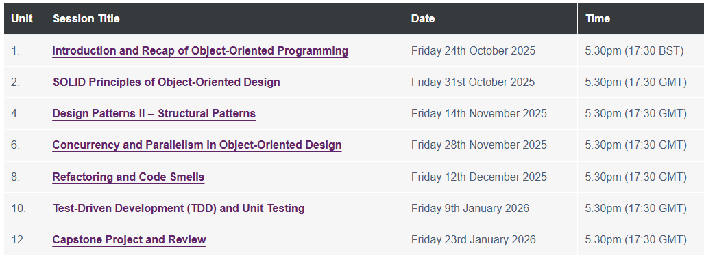
The organisation of the Seminars!

Slide 6
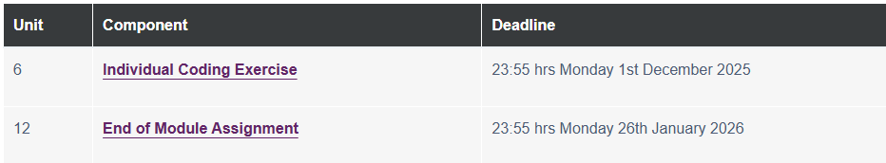
Deadlines of Assignment Submission

Slide 7
Concept of OOP
OOP is a programming approach that organises software design around objects (data structures containing attributes and methods) rather than functions and logic.
OOP represents real-world entities (e.g., cars, users, bank accounts) as objects with properties (attributes) and behaviours (methods).
OOP relies on four key principles: Encapsulation, Inheritance, Polymorphism, and Abstraction

Slide 8
Concepts of OOP
OOP languages and environments are designed around key principles that promote modularity, reusability, and maintainability. Some of the main characteristics are:
Class & Object
Inheritance
Polymorphism
Abstraction
Encapsulation

Slide 9
Concept of Classes and Objects
Class and Object:
Class is a blueprint for creating objects (defines attributes and methods)
An object is an instance of a class
class Car:
def __init__(self, brand, model):
self.brand = brand # Attribute
self.model = model
def display_info(self): # Method
print(f"{self.brand} {self.model}")
# Creating an object
my_car = Car("Toyota", "Corolla")
my_car.display_info() # Output: Toyota Corolla

Slide 10
Concept of Inheritance
Inheritance is a fundamental OOP concept where a child class (subclass) inherits attributes and methods from a parent class (superclass).
Inheritance establishes an “is-a” relationship (e.g., a Car is a Vehicle) and prompts:
- Code Reuse
- Hierarchical Organisation
- Polymorphism
How Inheritance Works?
class Vehicle: # Parent class
def __init__(self, brand):
self.brand = brand
def start_engine(self):
print("Engine started!")
class Car(Vehicle): # Child class (inherits from Vehicle)
def __init__(self, brand, model):
super().__init__(brand) # Calls parent's __init__
self.model = model
# Usage
my_car = Car("Tesla", "Model S")
my_car.start_engine() # Inherited method
print(my_car.brand) # Inherited attribute
Output: Engine started!
Tesla

Slide 11
Concepts of Polymorphism & Abstraction
Polymorphism (Many Forms):
The ability to different classes to respond to the same method call in different ways.
Achieved via method overriding and method overloading.
Abstraction (Hide complexity):
Hiding complex implementation details and showing only essential features.
Achieved using abstract classes and interfaces.

Slide 12
Concepts of Encapsulation
Encapsulation (Data Hiding):
Bundling data (attributes) and methods that operate on the data into a single unit (class).
Restricts direct access to some components (using private or protected access modifiers)
class BankAccount:
def __init__(self, balance):
self.__balance = balance # Private attribute
def deposit(self, amount):
self.__balance += amount
def get_balance(self): # Getter method
return self.__balance
account = BankAccount(1000)
account.deposit(500)
print(account.get_balance()) # Output: 1500
# account.__balance # Error (private attribute)

Slide 13
Seminar Task
Create a class hierarchy for a simple vehicle management system (e.g., Vehicle as a base class, with subclasses like Car, Bike, and Truck).
The Python code will be shared through the announcement!

Slide 14
Reference!
V.M. Hariharan et al. (2023) Python Programming by Pearson. Pearson India. https://learning.oreilly.com/library/view/python-programming-by/9789357053303/?sso_link=yes&sso_link_from=university-of-essex
Matthes, E. (2023) Python Crash Course: A Hands-On, Project-Based Introduction to Programming. 3rd Edition. New York: No Starch Press. https://learning.oreilly.com/library/view/python-crash-course/9781098156664/p01.xhtml
Lott, S. F. & Phillips, D. (2021) Python Object-Oriented Programming: Build Robust and Maintainable Object-Oriented Python Applications and Libraries. Fourth edition. Birmingham: Packt Publishing, Limited. https://ebookcentral.proquest.com/lib/universityofessex-ebooks/detail.action?docID=6680969&pq-origsite=primo
Kalb, I. (2022) Object-Oriented Python. No Starch Press. https://learning.oreilly.com/library/view/object-oriented-python/9781098129842/?sso_link=yes&sso_link_from=university-of-essex

